Slide 1
Metaphor in an online discussion forum for survivors of relationship abuse You think your ex is a nurse shark, huh?
Susan Nacey
RaAM11, July 2016

Slide 2
The language of betrayal
Notes:
People who have expereienced (or are in the midst of) some form of intimate betrayal, which may be characterized as abuse.
This abuse is always mental and emotional, but sometimes manifests itself in other forms – e.g. physical, financial, etc.
Traumatized, often suffering from Post traumatic stress disorder, diagnosed or not.
Often this seems to be the only place people discuss this (and a therapis, if they an afford and find one). Otherwise seen as bitter. Aren’t you over this yet?
And there are all sorts of stories here
Prototypical survivor is a woman.
The relationship between the Survivor (Victim) and abuser is typically a love relationship (heterosexual, homosecual) and very often involves long-term infidelity with at least one other person, an «OW», but sometimes a series of people. Very often the infidelity/ double life has somehow been reveal/unravelled, and the Survivor who writes in this forum stumble across the forum while trying to figure out what happened & how this person that they thought had known was actually a person that was someone they didn’t recognize.
Relationships may have been realtively short-term (a few months) or they may have lasted decades. May still be ongoing, or back and forth.
So they establish a username (anonymous) and start posting about their situation & receive feedback from any other poster who wants to answer.
Asynchronous posts, but many threads have concnetrated posts, covering a relatively short time span. At any time, however, an older thread might be picked up by a poster and renewed. And some threads are continually growing… like A thread ‘things I’m happy about now that the relationship is over’
Other abusive relationships dicussed. Parent/child, between siblings or friends, employer/employee.
Men are typically the abuser, but not always--- there are also many female abusers.
The forum is written in English, but the users can be from anywhere. I imagine most are US or UK- based. Some say that English is not their L1.
As you can imagine, this is a very emotional topic and metaphorical language naturally arises….a resource enabling posters to share their experience, and maybe make sense of their experience.
This is what I wanted to explore.. The language of betrayal.

Slide 3
Research questions
What metaphorical expressions do survivors of relationship abuse use when communicating about their experience?
How do survivors of relationship abuse use metaphor to communicate about their experiences and attitudes?
How may researchers harness ‘big data’ to study metaphor?
Notes:
My general research questions
First exploration of the material.
Also trying to get used to working with huges amounts of data,
Big data = a term that refers to both the troves of digital data available online AND storage, analysis and processing techniiques to deal with this data

Slide 4
Material and methods
Notes:
The empirical data consists of the metaphorical language produced in a publically available online discussion forum for anonymous posters, accessible without password protection. The forum allows survivors of relationship abuse to start and/or respond to threads about their experience in an abusive relationship (usually with a love partner, but sometimes a family member, colleague, and/or platonic friend).
Collected 47.5 million words in total from postings in different themes made during a 6-year period. Spent alot of time collecting and preapering the data ?+looking at the ethics of using this type of data. (BAAL paper)
This project looks at postings in one of the themes – about 1/5 of the data - and for one semantic tag; L2 Living creatures: animals, birds, etc.
>9.6 million words
Followed the example set by the MELC project in Lancaster.
Wmatirx= Interested in the semantic tags to help me identify metaphor. Looking for words tagged with semantic domains that – at least in their basick senses- would seem out of place given the context.
Wmatrix gives me the concordance lines, but only in the data as a whole. I needed to be able to trace the utteraces back to individual posters in order to be able to say something about dispersion.

Slide 5
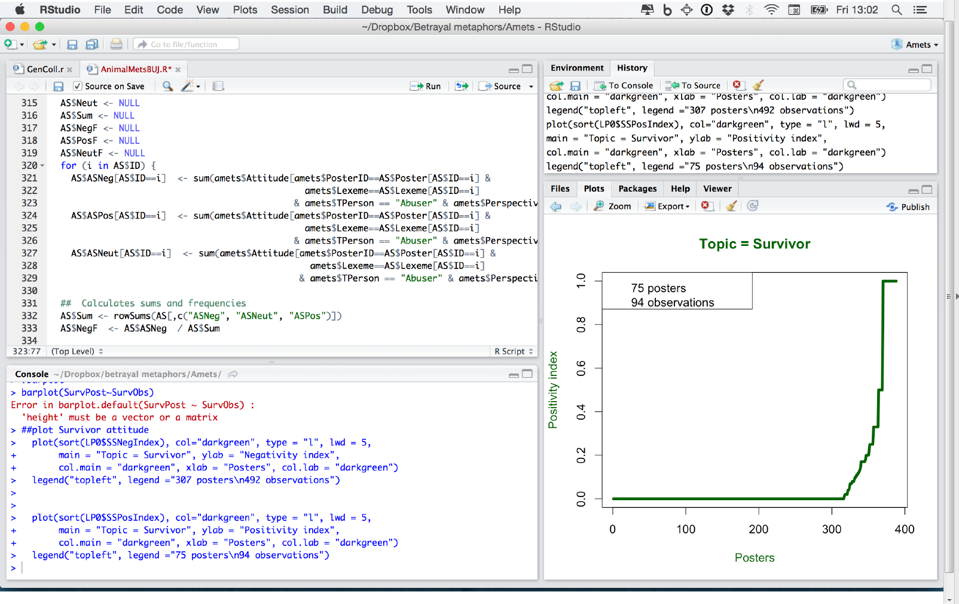
Notes:
Then made up a database in Filemake Pro. Coded each concorndance line for a number of factors – the first of which was to filter out words tht were not met in use.
Used MIPVU to decide about metaphoricity. Identified indirect metaphors, where the basic meaning of the term in question differs from the the contextual meaning...
and direct metaphors where the basic and contextual meaning are the same, but there is nevertheless some sort of underlying metaphorical comparison – such as you find in analogies and similes.
Finally, my preliminary coding was transferred to R Studio for statistical analysis.

Slide 6
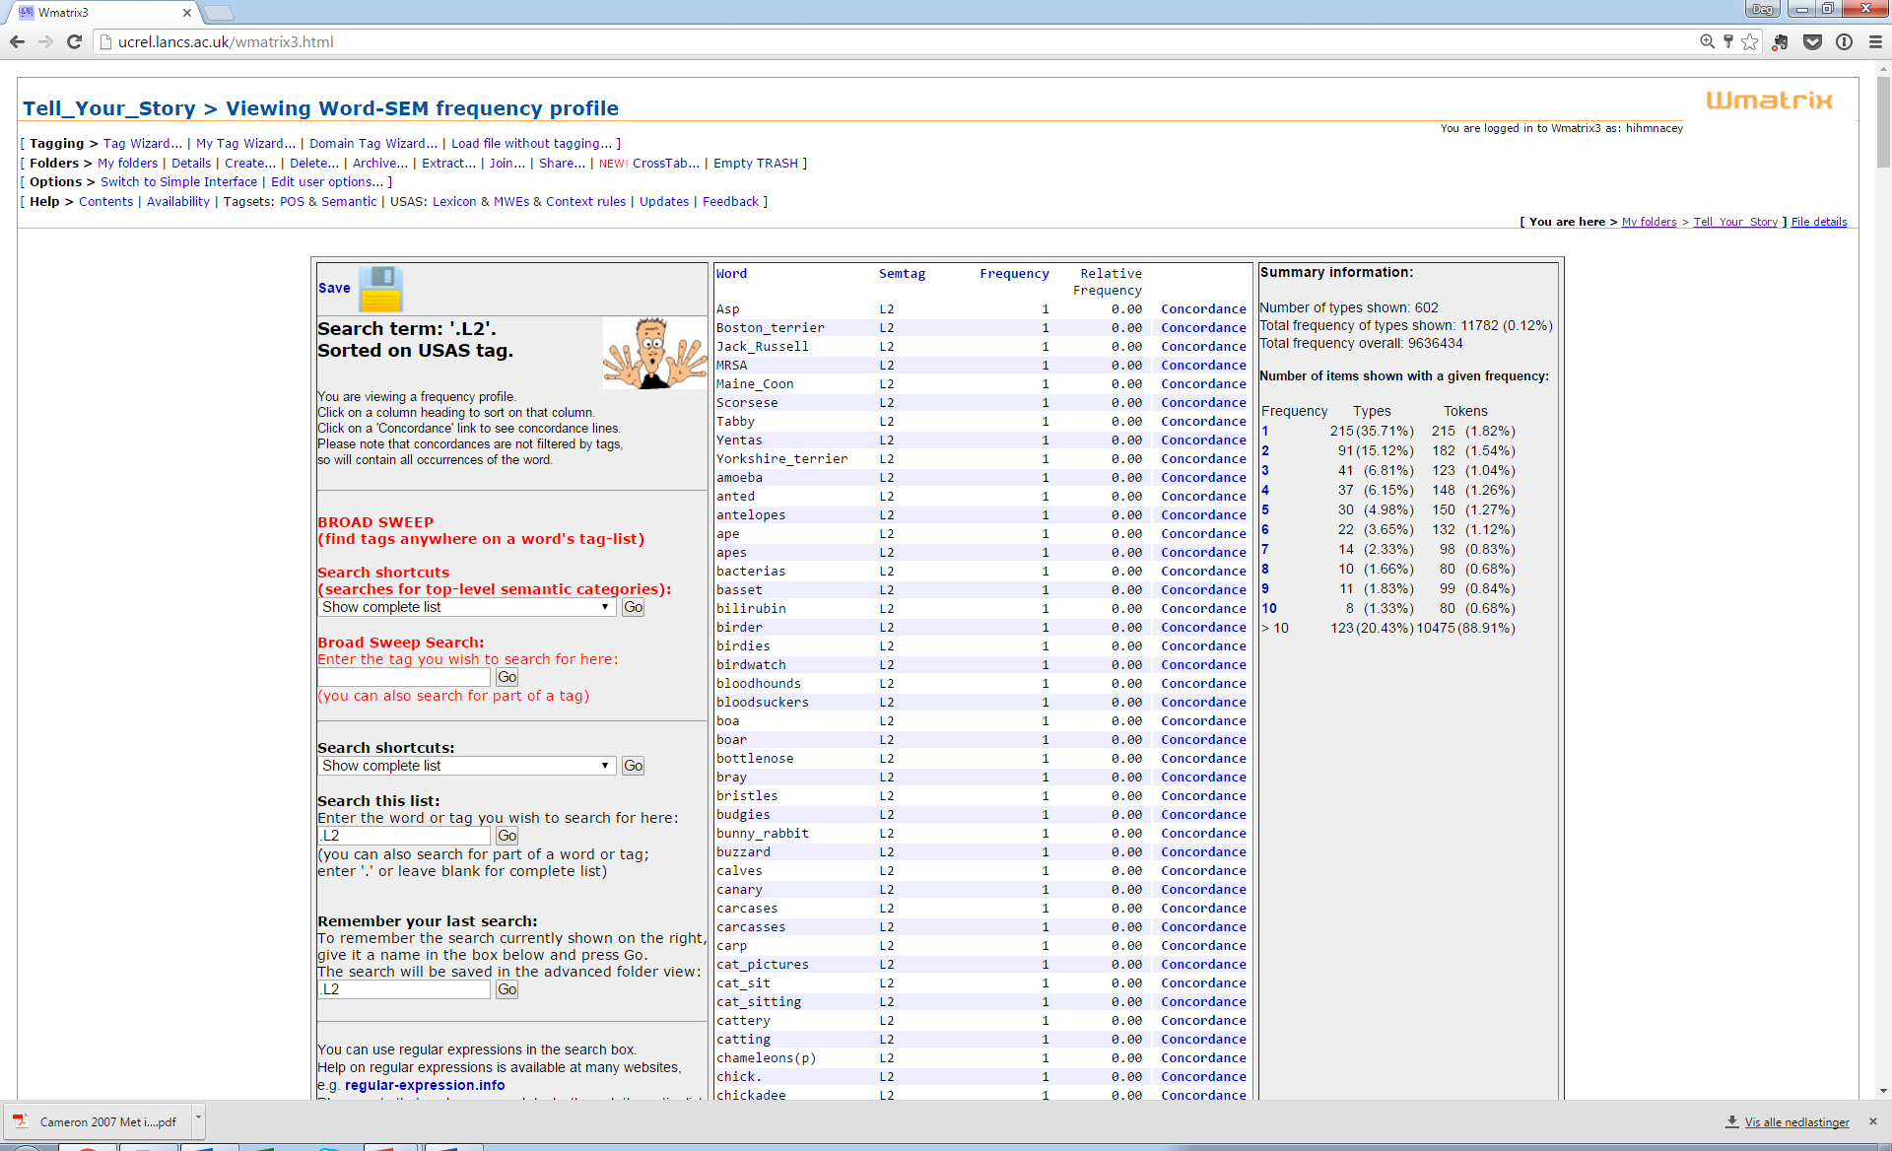
Data overview

Slide 7
Data overview
Frequency | Types | Tokens
4 | 37 | 148
5 | 30 | 150
6 | 22 | 132
7 | 14 | 98
8 | 10 | 80
9 | 11 | 99
10 | 8 | 80
>10 | 123 | 10475
total | 255 | 11262
Excluded 59 types / 1799 tokens
9463 concordance lines
602 types, 11782 tokens
Notes:
This is a lot of material .. started by looking only a one tag.
L2 Living creatures: animals, birds, etc.
Excluded hits with a frequency of 3 or fewer (time-counsuming + lots of them, many not metaphorical.. sometimes couldn’t be traced to the poster + discarded anywayss)
Also excluded from the search were tokens tagged as L2 that were somehow linked to animals: ‘nest’, ‘eggshells’, ‘vet’, etc.
Only looked for Living creatures.

Slide 8
Metaphor:
You are his ‘mouse’ and he is a cat. (indirect)
He is Mr. Nice Guy again, it’s like a cat playing with a mouse. (direct)
Not metaphor:
He wanted me to take care of his cat. (literal)
I think I am just going to swear off men and become a cat lady. (metonymy)
DFMA:
I went into the ER received a CAT scan.
9463 tokens
Metaphor
Not metaphor
DFMA
4368 tokens
4599 tokens
496 tokens
93 lexemes
%
Notes:
He wanted me to take care of his cat, but after I found out about everything I decided I was totally done
taking care for his things in any possible way.
Metonymy: Fuzzy line between metonymy and metaphor + I don’t have a metonymy id procedure, but there were some things I categorized a metonymy. Cat lady: Animal owned stands for person, Bunny boiler.. Action stands for person
Rejected for metaphor analysis:
Spelling mistakes/typos: ‘beast interests’, ‘night mare’, ‘hen’ (=‘then’), ‘moth’ (e.g. ‘a six-moth-old baby’) (‘prey’ for ‘pray’)
Names of movies & books: The Wolf of Wall Street, Lord of the Flies, Snakes in Suits
Perjorative: Holy Cow, Flip the bird
Names: Robert Hare, Dixie Chicks, Pseudonyms
Codified compounds: pet peeve, pet name (but not pet rock)
Acronyms

Slide 9
Informants
4042 threads
4124 posters
1676 threads
41% of total
1271 posters
31% of total
Total
Animal metaphors
Min = 1, Max= 95, IQR = 2
Notes:
9.6 million words explored. = 4042 threads, 4124 individual posters
IQR = interquartile range, a measure of statistical dispersion, Q3 – Q1 (In a boxplot, looks at just distnce in that central box.%, ignores outliers, better for skewed data than sd

Slide 10
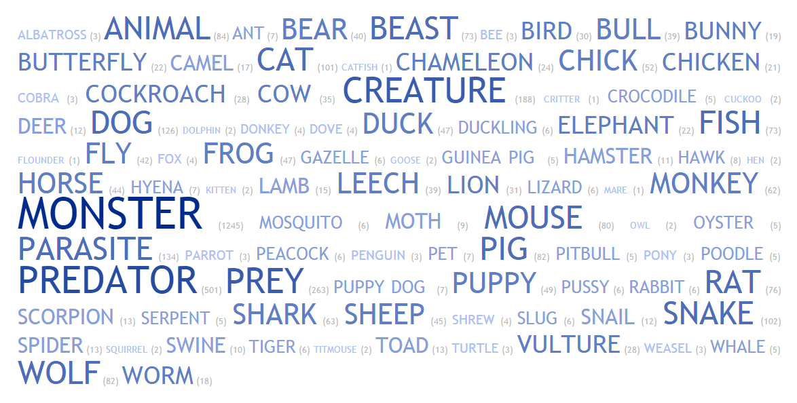
What animals/living creatures do survivors drawn upon to communicate about their experience?
Wordcloud created at http://tagcrowd.com
Notes:
http://tagcrowd.com
A total of 93 different lexemes.
Numbers indicate the observed occurrence of each.
Both the script size and color shading indicate the relative frequency of each.
Top 10=
Monster 1245
Predator 501
Prey 263
Creature 188
Parasite 134
Dog 126
Snake 101
Animal 84
Wolf 82
Pig 82
Mouse 80
Rat, Fish, Beast, Shark, Monkey…

Slide 11
Complimentary survivor-abuser ‘roles’
Notes:
Partially the high relative frequency of prey/predator/mouse/cat
Wordcloud created at http://tagcrowd.com

Slide 12
Are animals always negative?
I am not saying this out of spite, but they are predators ... animals in the truest sense of the word.
...this time when he left , I felt like a bird released from a cage ... I was fearful of being recaptured...
And infatuation is really just a crush, puppy love, it’s not real.
Negativity Index / Positivity Index / Neutrality Index
Notes:
Index..
takes into account it negative frequency per user and lexeme.
scael from 0-1
closer to one = more negative /positive /neutaral

Slide 13
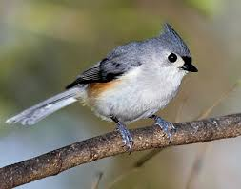
”Negative” living creatures
Notes:
If value = 0, the lexeme was never used in a positive sense; it was always either negative or neutral.
LIon= Positive / Negative...
heart of a lion.... otherwise being a lion = negative, being a lioness = positive

Slide 14
I have never see anyone on the planet tell more lies - she lies like a snake.
You are being stalked like a tiny mouse to a lion.
I know I am stronger now . I am a lioness now. I can make it on my own.
...figure out what you need to do. The old how do you eat an elephant, one bite at a time type of thing trying to help her get through it...
DO NOT RESPOND . Do not make eye contact . Act in public like a scared titmouse. File all charges you can. Talk to your public defender.
Notes:
Dolphin:
Because the original poster ahd written:
Today was a hard and bitter day. Definitely oceanic. Definitely still in the swim. So very very glad that y'all are here. No one in my real world life really and truly gets what it means to recover from a relationship like this. I cannot imagine how alone and unsafe I would feel if this site did not exist.
LION: often negative (except for heart of a lion). Lioness = positive. like mother bear = Female predators.
Not cow/mare = negative, hen = neutral (hen do, hen weekend). Chick =
A responder plays in this:
So what I can do, what I can do is just add that you are swimming in your ocean something like a dolphin and I am very very proud for you and for all you are doing to be a wise and good parent.

Slide 15
Positivity index
Notes:
wonderful, wondrous, loveliest

Slide 16
”Positive” lexemes
So what I can do, what I can do is just add that you are swimming in your ocean something like a dolphin and I am very very proud for you and for all you are doing to be a wise and good parent.
I am working on getting wise as a serpent. I too am very compassionate and do not want to lose that part of myself...
vs.
...and flicked his tongue at me like a serpent, while calling me a b****, whore , c*** , baby-killer...
what a wonderful analogy ... first the rebirth and then the butterfly...nice...
I have gone from a happy social butterfly to a shut-in.
Notes:
Dolphin = example of chaining:
I forced myself to leave the house and do some Xmas shopping despite the sobbing until I puked escapade. I feel shaken. Today was a hard and bitter day. Definitely oceanic. Definitely still in the swim. So very very glad that y'all are here. No one in my real world life really and truly gets what it means to recover from a relationship like this. I cannot imagine how alone and unsafe I would feel if this site did not exist.
Serpent: positive Matthew 10:16English Standard Version (ESV)
Persecution Will Come
16 “Behold, I am sending you out as sheep in the midst of wolves, so be wise as serpents and innocent as doves.
end of crossrefs

Slide 17
What are they communicating about using ‘animal’ metaphors?
Person:
The OW is his ATM cash cow, keeps an expensive and luxurious roof over his head
Experience:
omg I exactly did that running after him like a dog and he used to kick me
Other:
we started trying to start a family putting the "cart before the horse with regard to marriage."
Notes:
Usually talking about a person
Survivor: themselves, Addresee or survivors in general
Abuser: my abuser/your abuser/ abusers in generla
Couple : the abuser + survivor
OW or OM
Third party, for ex. Children
Humankind… everyone
Couple Humankind OW Third party Other Survivor Abuser
2 54 73 109 423 750 2958
Other--- not a person
But all these, the main focus of animal metaphors is themsleves+ the abuser.. But mostly the abuser

Slide 18
Animal metaphors about Survivors vs. Animal metaphors about Abusers
Notes:
When Perspective = Survivor
Sometimes perspective = someone else...Ex The abuser always said...

Slide 19
How do the posters use animal metaphors to communicate about their abuser?
Notes:
When Topic= Abuser & Perspective = Survivor
10 posters + 10 occurences = possite
925 posters with 957 (?) occurrrences = negative
Even the ’positive’ ones are negative...

Slide 20
’Positive’ about the abuser?
N is healthy as a horse.
I also thought of my husband as a lion, a man who was willing to take on the world for what he believed...
because he suckered you into believing he was this wonderful creature who cared,
not the empty shell of a person with no soul.

Slide 21
How do the posters use animal metaphors to communicate about themselves?
Notes:
Attitude When Topic= survivor and Perspective = Survivor… How are they talking about themselves?
v

Slide 22
And yet , I am checking my phone like a trained monkey to see if he has blessed me with any more abuse...
We are not their best friends, we are their prey.
I sometimes feel like a positive energy leech. With them not knowing just how much they 're helping me.
I have three children and feel like a mother bear protecting her cubs in a cave.

Slide 23
Concluding thoughts
Metaphor is clearly important when communicating about such an emotional topic as betrayal.
Oodles of data
Important data
Have only scratched the surface
Other semantic tags
Similes and analogies
Bitesize pieces...
Lots of as yet unanswered methodological questions...
Notes:
That metaphor is important when talking about intense emotional experiences should come as no surprise to metaphor researchers.
Animal mets not uncommon... albeit in varying degrees.
Important in the sense that it tells the truth. the ’ex’ is often accused of being bitter, of trying to get revenge...but here they are just trying to heal +make sense of their experience..
A number of animal met are used exclusivley in a negative sense...others positive/neutral in varying degrees
Scratched the surface...similes other tags: violence/war/milarytr, etc.
How to I get at this data...
For example, in so much data how do I find those times when meaning is co-constructed through metaphor, in a consistent way??
An example: Next slide
Metaphor is important when communicating about an emotional topic such as betrayal
’Animal’ metaphors are not uncommon:
2/5 of the threads
1/3 of the posters
Many ’animal’ metaphors = exclusively negative....but far from all
’Animal’ metaphors referring to abusers = extremely negative
’Animal’ metaphor referring to posters = quite negative, but also somewhat positive

Slide 24
A’s abuser = ’Jaws’
B: I started calling the X "Jaws" too. I had a dream about a great white shark circling me off and on during the relationshit with him. (The good old subconscious!!)They are very much like sharks, even to the dead look they get in their eyes!!!
C: Maybe, our subconscious picked up on cognitive dissonance during the relationship and was letting us know a predator is out there. I mean, is there a better predator on the face of the earth? Course, my Xs not of the caliber of a great white. Hes more like a nurse shark, or is that a nasty label to those nurse sharks? I mean, what did they ever do to us?
A: You're right. Now I feel bad for putting down sharks. I guess I've always been so afraid of them because I came from the generation when JAWS was in theaters so pop culture was everything JAWS. We'd play JAWS in the pool instead of Marco Polo. You think your ex is a nurse shark, huh? Did you know they're bottom feeders?
C: As to knowing about Nurse Sharks being bottom feeders, um, yeah, you could say I knew...HA!:
Notes:
C starts of thread, referring to abuser as Jaws (page 1 of a conversation)
A picks up on that much later (page 5 of the conversation)
Rest of A:
They also KNOW when someone is vulnerable, and take advantage of that, so please don't beat yourself up anymore. You were unhappy and reached out to someone you knew long ago. That person repulsed you, but also drew you in when you pulled away. It's very normal, from what I've read to have odd mixed feelings about them at first....like you sense the shark in the water, but you can't quite see it, so maybe it isn't there....and we want them to be guppies, so we convince ourselves that's what they are. Sorry about the rambling fish references....
These quotes are mixed are selected, mixed in with lots of other discussion.
How to find???
Zsofia humor in cancer talk gave me one idea.
Also collaboration.

Slide 25
’Generic’ animal terms

Slide 26
Negativity Index / Positivity Index / Neutrality Index
Calculated for each lexeme:
Negative frequency = (Negative occurrences / All occurrences) per poster
Negative index = (Sum of Negative frequencies / # individual posters) per lexeme
Example for Lexeme “X”:
Poster | NegO | PosO | NeutO | NegF | PosF | NeutF
1 | 5 | 0 | 0 | 1 | 0 | 0
2 | 1 | 0 | 0 | 1 | 0 | 0
3 | 4 | 1 | 0 | 0.8 | 0.2 | 0
3 Posters |  |  |  | 2.8 | 0.2 | 0
NegIndex = 2.8/3 = 0.93
PosIndex = 02./3 = 0.07
NeutIndex = 0/3 = 0
Notes:
How are the lexemes used?
Nr adds !!! (gentle as a dove, wise as a serpent! LOL)
In my analysis, I had coded each use for attitude
How calculated:
For each lexeme, I first calculated a negative frequency:
NegF= ( #Neg occurences of Lexeme X / Sum of all occurences of Lexeme X) per poster
Afterwards, I calculated a ‘negativity index’
Lexeme X Negativity Index = Sum(Posters’ Neg F)/# of individual posters per lexeme
Example:
Lexeme Neg Neut Pos Negf PosF Poster
DOG 5 0 0 1 0 1
DOG 1 0 0 1 0 2
DOG 4 0 1 0.8 0.2 3
NegIndex= 2.8 /3 = 0.93
PosIndex = 0.2/3 = 0.07
Using frequencies instead of sums helps to account for individual variation.
WAIT AND EXPLAIN THAT WHAT IS IMPORTANT IN THE NEXT SLIDE IS THE LINE, SHOWING THE TREND

Slide 27
Negative index / Positive Index / Neutral Index per poster
Calculated for each poster:
Negative frequency = (Negative occurrences / All occurrences) per lexeme
Negative index = (Sum of Negative frequencies / sum of individual lexemes) per poster
Example for Poster “X”:
Lexeme | NegO | PosO | NeutO | NegF | PosF | NeutF
ANIMAL | 2 | 0 | 0 | 1 | 0 | 0
DOG | 1 | 0 | 1 | 0.5 | 0 | 0.5
MONSTER | 10 | 0 | 0 | 1 | 0 | 0
3 lexemes |  |  |  | 2.5 | 0 | 0.5
NegIndex = 2.5/3 = 0.83
PosIndex = 0 /3 = 0
NeutIndex = 0.5/3= 0.17
Notes:
Starts with LPA0..attitude of lexemes per poster, when >0. Renamed to AttSS
Negativity index
AttSS$SSNeg = # of occurrences for each poster & lexeme where Attitude = Negative.
AttSS$Sum = sum per poster and lexeme of SSNEg, Sspos, SSNeut for each lexeme
NegF = # of negative attitude occurences / sum of negative occurrences per poster and lexeme
Example
Poster Lexeme SSNeg SSPos SSNeut Sum NegF
ANIMAL 2 0 0 2 2/2 =1
1 DOG 1 0 1 2 ½=0.5
[]LexemePoster$AttSSNeg = Adds up all occurences each poster has written negatively about themselves (to weed out those who don’t): 393 left]
Index per poster:
NegF(animal+ dog) / total number of posts per poster [including those where poster talking about other things]

